Slide 1
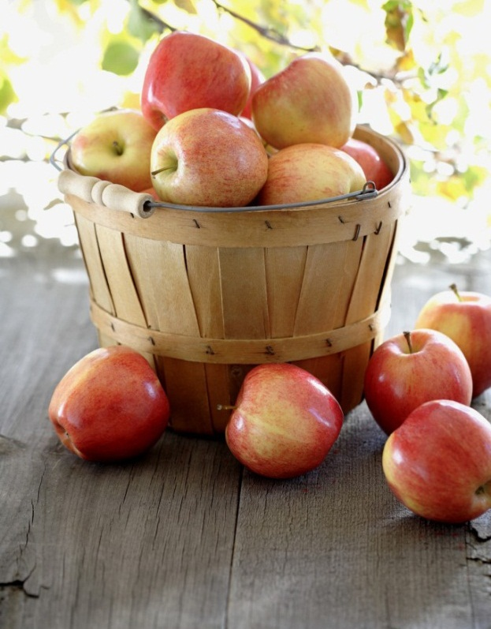
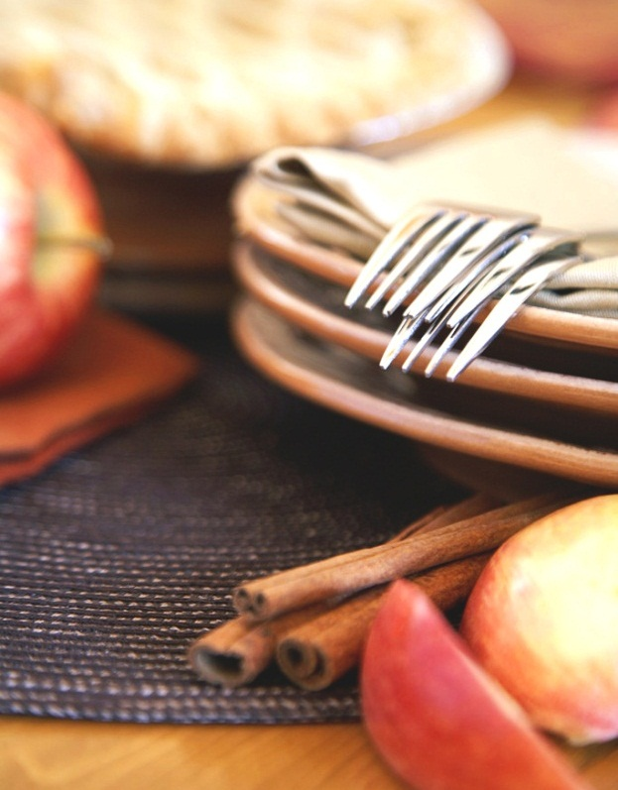
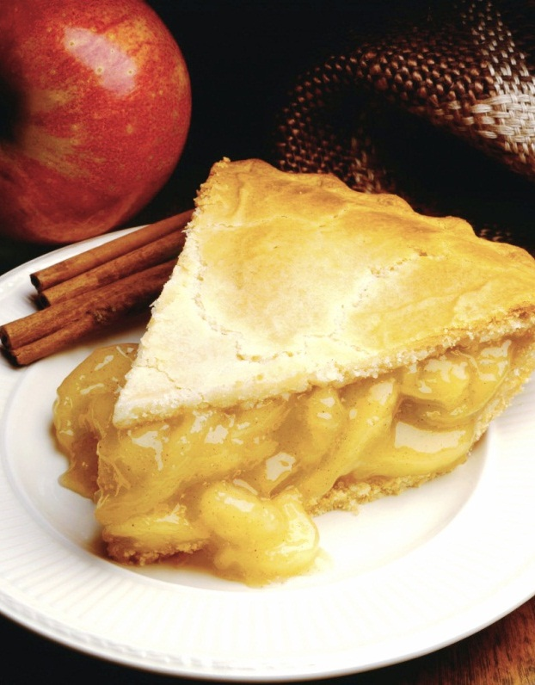
New Restaurant in Queretaro, Mx
Coursera Capstone Project

Slide 2
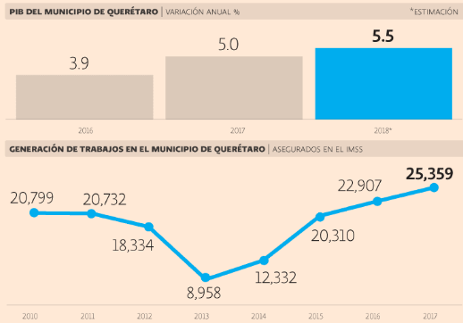
Economical growth
Queretaro is the 3rd mexican city with the highest economical growth in the last years. It has had a stedy increase in its GDP and new job creation

Slide 3
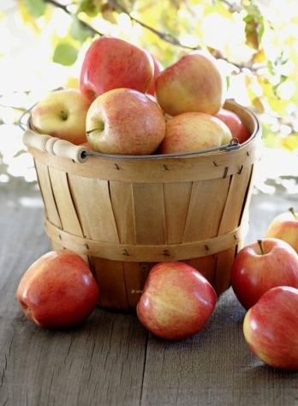
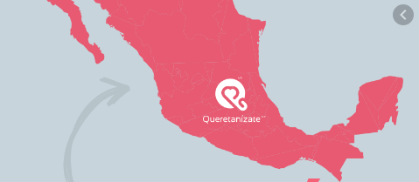
More and more people are moving to Queretaro, wich is a great opportunity to new bussinesses, including restaurants

Slide 4
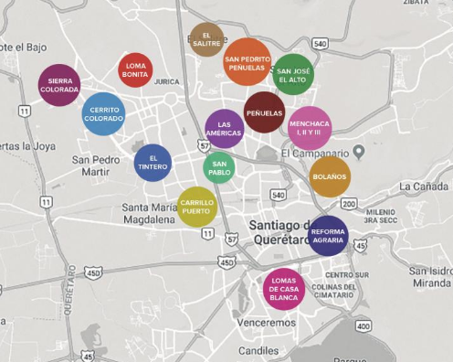
There are areas with high criminality rates, but downtown Queretaro is not considered a dangerous area by the population.

Slide 5
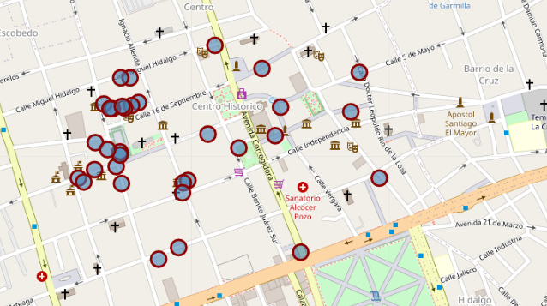
Restaurants in Downtown area
Type | #
Mexican | 11
Bars/Breweries | 6
Cafes | 5
Italian | 3
Ice cream | 2
Creole/cajun | 1
Frech | 1
Balcanic | 1
Seafood | 1

Slide 6
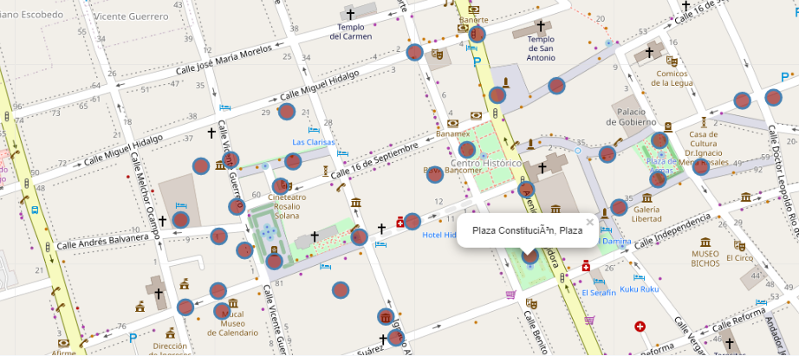
Attractions in Downtown area
Type | #
Park/Plaza | 6
Museum | 5
Cafes | 5
Art gallery/shop | 4
Hotel | 4
Theather | 2
Movie Theater | 1
Church | 1

Slide 7
Reccomendations
Downtown area is an excellent area to star a new restaurants, there are a lot of attractions and parks, and they assure a lot of flow of people in the area all the time.
Mexican restaurant is not a good idea, most of restaurants in the area are Mexican, and are widespread all over the area.
European cuisine is also an already seen business, since there are one balcanic, 3 italian and one French cuisine restaurants.
We recommend open an Asian cuisine restaurant: Japanese, Chinese, Thai or Indian. They are the more reknonwn in other places. Or a new concept of restaurant.
Further analysis is necessary to determine the exact location, according to available rental places, the costs, and the budget

